Slide 1
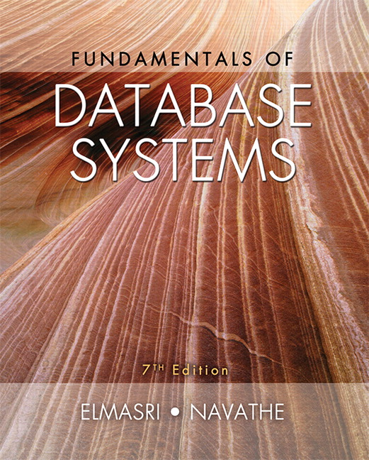

Slide 2
CHAPTER 30
Database Security

Slide 3
30.1 Introduction to Database Security Issues
Database security a broad area
Legal, ethical, policy, and system-related issues
Threats to databases
Loss of integrity
Improper modification of information
Loss of availability
Legitimate user cannot access data objects
Loss of confidentiality
Unauthorized disclosure of confidential information

Slide 4
A DBMS typically includes a database security and authorization subsystem that is responsible for ensuring the security of portions of a database against unauthorized access.

Slide 5
types of database security mechanisms
Discretionary security mechanisms.
used to grant privileges to users
including the capability to access specific data files, records (such as read, insert, delete, or update).
Mandatory security mechanisms.
used to enforce multilevel security by classifying the data and users into various security classes
implement the appropriate security policy of the organization.

Slide 6
Introduction to Database Security Issues (cont’d.)
Database works as part of a network of services
Applications, Web servers, firewalls, SSL terminators, and security monitoring systems
Types of database control measures
Access control
Inference control
Flow control
Encryption

Slide 7
Control measures
Access control
Handled by creating user accounts and passwords
To control the login process by the DBMS.
Inference control
Must ensure information about individuals cannot be accessed
Flow control
Prevents information from flowing to unauthorized users
Data encryption
Used to protect sensitive transmitted data
The data is encoded using some coding algorithms

Slide 8
Database Security and the DBA
Database administrator (DBA)
Central authority for administering and managing database system
DBA account in the DBMS, sometimes called a Superuser or system account
DBA-privileged commands
Account creation
Privilege granting
Privilege revocation
Security level assignment
Note:The DBA is responsible for the overall security of the database system

Slide 9
Access Control, User Accounts, and Database Audits
The user must log in to the DBMS by entering the account number and password whenever database access is needed.
Login session
Sequence of database operations performed by a certain user from the login to the logout.
Recorded in system log
Database audit
Reviewing log to examine all accesses and operations applied to the database during a certain time period
A database log that is used mainly for security purposes serves as an audit trail.

Slide 10
Sensitive Data and Types of Disclosures
Sensitivity of data: is a measure of the importance assigned to the data by its owner for the purpose of denoting its need for protection.
Several factors can cause data to be classified as sensitive:
Inherently sensitive
From a sensitive source
Declared sensitive
A sensitive attribute or sensitive record
Sensitivity in relation to previously disclosed data

Slide 11
Sensitive Data and Types of Disclosures (cont’d.)
Factors in deciding whether it is safe to reveal the data
Data availability
Not available when being updated
Access acceptability
Data should only be revealed to Authorized users
Authenticity assurance
External characteristics of the user should be considered before granting access.
Example: access only allowed during working hours

Slide 12
Sensitive Data and Types of Disclosures (cont’d.)
Typically a tradeoff between precision and security
Precision
Protect all sensitive data while making available as much nonsensitive data as possible
Security
Means of ensuring data kept safe from corruption and access is suitably controlled
Note:The ideal combination is to maintain perfect security with maximum precision.

Slide 13
Relationship Between Information Security and Information Privacy
Concept of privacy goes beyond security
Ability of individuals to control the terms under which their personal information is acquired and used
Security a required building block for privacy
Preventing storage of personal information
Ensuring appropriate use of personal information
Trust relates to both security and privacy

Slide 14
30.2 Discretionary Access Control Based on Granting and Revoking Privileges
Two levels for assigning privileges to use a database system
Account level: the DBA specifies the particular privileges that each account holds independently of the relations in the database.
Example: CREATE SCHEMA or CREATE TABLE privilege
Not defined for SQL2
Relation (or table) level: the DBA can control the privilege to access each individual relation or view in the database.
Defined for SQL2
Access matrix model

Slide 15
Discretionary Access Control (cont’d.)
Relation or table level (cont’d.)
Each relation R assigned an owner account
Owner of a relation given all privileges on that relation
Owner can grant privileges to other users on any owned relation
types of privileges can be granted on each individual relation R:
SELECT (retrieval or read) privilege on R
Modification privilege on R
References privilege on R

Slide 16
Specifying Privileges Through the Use of Views
Consider owner A of relation R and other party B
A can create view V of R that includes only attributes A wants B to access
Grant SELECT on V to B
Can define the view with a query that selects only those tuples from R that A wants B to access

Slide 17
Revocation and Propagation of Privileges
Revoking of Privileges
Useful for granting a privilege temporarily
REVOKE command used to cancel a privilege
Propagation of privileges using the GRANT OPTION
If GRANT OPTION is given, B can grant privilege to other accounts
DBMS must keep track of how privileges were granted if DBMS allows propagation

Slide 18
Specifying Limits on Propagation of Privileges (cont’d.)
Horizontal and vertical propagation limits
Limiting horizontal propagation to an integer number i
Account B given the GRANT OPTION can grant the privilege to at most i other accounts
Vertical propagation limits the depth of the granting of privileges. Granting a privilege with a vertical propagation of zero is equivalent to granting the privilege with no GRANT OPTION.
is more complicated
Note: Not available currently in SQL or other relational systems
Notes:
If account A grants a privilege to
account B with the vertical propagation set to an integer number j > 0, this means
that the account B has the GRANT OPTION on that privilege, but B can grant the
privilege to other accounts only with a vertical propagation less than j.

Slide 19
30.3 Mandatory Access Control and Role-Based Access Control for Multilevel Security
Mandatory access control (MAC)
Additional security policy that classifies data and users based on security classes
Typical security classes
Top secret TS Highest
Secret S
Confidential C
Unclassified U Lowest
Bell-LaPadula model
Used for multi level security
Classifies each Subject and object into one of security classifications (TS, S, C and U).

Slide 20
Mandatory Access Control and Role-Based Access Control for Multilevel Security (cont’d.)
Simple security property
A subject S is not allowed read access to object O unless class(S) ≥ class(O)
Star property
A subject S is not allowed to write an object O unless class(S) ≤ class(O)
Prevent information from flowing from higher to lower classifications
Less intuitive
Attribute values and tuples considered as data objects

Slide 21
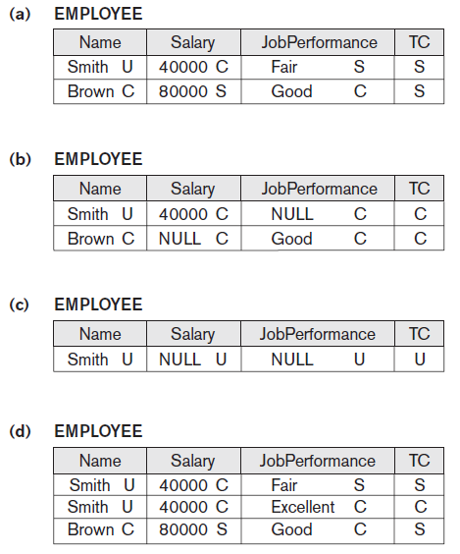
Figure 30.2 A multilevel relation to illustrate multilevel security (a) The original EMPLOYEE tuples (b) Appearance of EMPLOYEE after filtering for classification C users (c) Appearance of
EMPLOYEE after filtering
for classification U users
(d) Polyinstantiation of the
Smith tuple

Slide 22
Comparing Discretionary Access Control and Mandatory Access Control
DAC policies have a high degree of flexibility
Do not impose control on how information is propagated so it is vulnerable to malicious attacks
Mandatory policies ensure high degree of protection
Prevent illegal information flow
suitable for military and high-security types of applications
Rigid

Slide 23
Role-Based Access Control RBAC
Permissions associated with organizational roles rather than with individual users
Users are assigned to appropriate roles
Can be used with traditional discretionary and mandatory access control
Ensures that only authorized users in their specified roles are given access to certain data or resources.
Mutual exclusion of roles
Two roles are said to be mutually exclusive if both the roles cannot be used simultaneously by the user.
Identity management

Slide 24
Types of mutual exclusion of roles
Authorization time exclusion (Static)
two roles that have been specified as mutually exclusive cannot be part of a user’s authorization at the same time.
Runtime exclusion
both these roles can be authorized to one user but cannot be activated by the user at the same time.
Note: There are other variation in mutual exclusion of roles is that of complete and partial exclusion.

Slide 25
Label-Based Security and Row-Level Access Control
Sophisticated access control rules implemented by considering the data row by row
Each data row given a label
Used to prevent unauthorized users from viewing or altering certain data
Used to store information about data sensitivity
Provides finer granularity of data security by allowing the permissions to be set for each row and not just for the table or column
Label security policy
A policy defined by an administrator
Notes:
label security policy. Whenever data affected by the policy is accessed or queried through an application, the policy is automatically invoked. When a policy is implemented, a new column is added to each row in the schema. The added column contains the label for each row that reflects the sensitivity of the row as per the policy

Slide 26
XML Access Control
Digital signatures for XML
XML Signature Syntax and Processing specification (Canonicalization ).
Defines mechanisms for countersigning and transformations
XML encryption
XML Encryption Syntax and Processing specification
Defines XML vocabulary and processing rules for protecting confidentiality of XML documents
Notes:
canonicalization—to ensure that two instances of the same text produce the same digest for signing even if their representations differ slightly; for example, in typographic white space

Slide 27
Access Control Policies for the Web and Mobile Applications
E-commerce environments
are characterized by any transactions that are done electronically.
require elaborate access control policies that go beyond traditional DBMSs.
Content-based access control
allows one to express access control policies that take the protection object content into account.
Credentials
is a set of properties concerning a user that are relevant for security purposes

Slide 28
30.4 SQL Injection
SQL injection
Most common threat to database system
Other common threats (attacks)
Unauthorized privilege escalation
Privilege abuse
Denial of service
Weak authentication

Slide 29
SQL Injection Methods
Attacker injects a string input through the application
Changes or manipulates SQL statement to attacker’s advantage
An SQL injection attack such as
Unauthorized data manipulation or execution of system-level commands

Slide 30
SQL Injection Methods (types of injection.)
SQL manipulation
Changes an SQL command in the application
Example: adding conditions to the WHERE clause
Typical manipulation attack occurs during database login
Code injection
attempts to add additional SQL statements or commands to the existing SQL statement by exploiting a computer bug, which is caused by processing invalid data.
popular technique for system hacking or cracking
Function call injection
Database or operating system function call inserted into vulnerable SQL statement to manipulate data or make a privileged system call

Slide 31
Risks Associated with SQL Injection
Database fingerprinting
Denial of service
Bypassing authentication
Identifying injectable parameters
Executing remote commands
Performing privilege escalation

Slide 32
Protection Techniques
Blind variables (using parameterized statements)
Protects against injection attacks
Improves performance
Filtering input (input validation)
Remove escape characters from input strings by using the SQL Replace function.
Escape characters can be used to inject manipulation attacks
this technique is not reliable, because there can be a large number of escape characters
Function security
Standard and custom functions should be restricted

Slide 33

30.5 Introduction to Statistical Database Security
Statistical databases used to provide statistics about various populations
Users permitted to retrieve statistical information about the populations such as averages, sums, counts, maximums, minimums, and standard deviations.
Must prohibit retrieval of individual data.
Population: set of tuples of a relation (table) that satisfy some selection condition
Figure 30.3 The PERSON relation schema for illustrating statistical database security

Slide 34
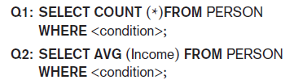
Introduction to Statistical Database Security (cont’d.)
Only statistical queries that that involve statistical aggregate functions such as COUNT, SUM, MIN, MAX, AVERAGE, and STANDARD DEVIATION. are allowed
Reducing the inference of individual information
Provide minimum threshold on number of tuples
Prohibit sequences of queries that refer to the same population of tuples
Introduce slight noise or inaccuracy
Partition the database
Store records in groups of minimum size

Slide 35
30.6 Introduction to Flow Control
Flow control
Regulates the distribution or flow of information among accessible objects
Checks information contained in some objects does not flow explicitly or implicitly into less protected objects
Flow policy
Specifies channels along which information is allowed to move
Simple form: confidential (C) and nonconfidential (N)

Slide 36
types of flow
Two types of flow can be distinguished:
explicit flows
which occur as a consequence of assignment instructions, such as Y:= f(X1,Xn,)
implicit flows
which are generated by conditional instructions, such as if f(Xm+1, … , Xn) then Y:= f (X1,Xm).

Slide 37
Introduction to Flow Control (cont’d.)
Covert channels
Allows information to pass from a higher classification level to a lower classification level through improper means
Covert channels can be classified into :
Timing channel
the information is conveyed by the timing of events or processes
requires temporal synchronization
Storage channel
information is conveyed by accessing system information or what is otherwise inaccessible to the user.
does not require temporal synchronization

Slide 38
30.7 Encryption and Public Key Infrastructures
Encryption converts data into cyphertext
Performed by applying an encryption algorithm to data using a prespecified encryption key
Resulting data must be decrypted using a decryption key to recover original data
Data Encryption Standard (DES)
Developed by the U.S. Government for use by the general public
Advanced Encryption Standard (AES)
More difficult to crack

Slide 39
Encryption and Public Key Infrastructures (cont’d.)
Symmetric key algorithms
Also called secret key algorithms
Need for sharing the secret key
Can apply some function to a user-supplied password string at both sender and receiver
Public (asymmetric) key encryption
Involves public key and private key
Private key is not transmitted
Two keys related mathematically
Very difficult to derive private key from public key

Slide 40
Encryption and Public Key Infrastructures (cont’d.)
Public (asymmetric) key encryption steps
Each user generates a pair of keys to be used for encryption and decryption of messages
Each user places public key in a public register or other accessible file
Keeps companion key private
Sender encrypts message using receiver’s public key
Receiver decrypts message using receiver’s private key
RSA public key encryption algorithm

Slide 41
Digital Signatures
is a means of associating a mark unique to an individual with a body of text. The mark should be unforgettable.
Consist of string of symbols
Each is unique
Making each function of the message it is signing together, along with a timestamp
Depends on secret number unique to the signer
Public key techniques used to create digital signatures

Slide 42
Digital Certificates
Combines value of a public key with the identity of the person or service that holds the corresponding private key into a digitally signed statement
Certificates are issued and signed by a certification authority (CA).
Information included in the certificate
Owner information
Public key of the owner
Date of certificate issue and validity period
Issuer identification
Digital signature

Slide 43
30.8 Privacy Issues and Preservation
Is Growing challenge for database security
To preserve data privacy we should even Limit performing large-scale data mining and analysis
Avoid building mammoth central warehouses for vital information
Violating security could expose all data
Distributed data mining algorithms minimizes the exchange of data needed to develop globally valid models.
To mitigate privacy risks associated with data mining.
Remove identity information in released data
Inject noise into the data
Must be able to estimate errors introduced

Slide 44
30.9 Challenges to Maintaining Database Security
Data quality
techniques and organizational solutions to assess and attest to the quality of data.
Quality stamps
Application-level recovery techniques to automatically repair incorrect data
The ETL (extract, transform, load) tools
Intellectual property rights
Digital watermarking techniques protect content from unauthorized duplication and distribution by enabling provable ownership of the content.

Slide 45
Challenges to Maintaining Database Security (cont’d.)
Database survivability (to prevent an attack) a DBMS should do:
Confinement
Damage assessment
Reconfiguration
Repair
Fault treatment

Slide 46
30.10 Oracle Label-Based Security
Oracle label security
Enables row-level access control
Every table or view has an associated security policy
Virtual private database (VPD) technology
Feature of the Oracle Enterprise Edition that adds predicates to user statements to limit their access in a transparent manner to the user and the application.
Provides access control based on policies.

Slide 47
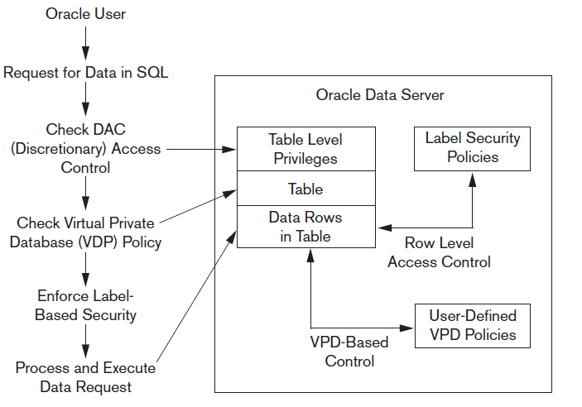
Label Security Architecture
Figure 30.4 Oracle label security architecture. Data from: Oracle (2007)

Slide 48
How Data Labels and User Labels Work Together
A user’s label
indicates the information the user is permitted to access.
determines the type of access (read or write) that the user has on that information.
When a table in the database has a label-based access associated with it
a row can be accessed only if the user’s label meets certain criteria .
Access is granted or denied based on the result of comparing the data label and the session label of the user.

Slide 49
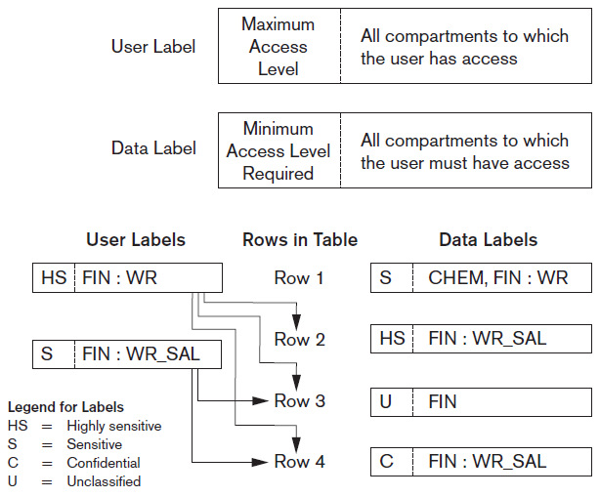
How Data Labels and User Labels Work Together
Figure 30.5 Data labels and user labels in Oracle. Data from: Oracle (2007)

Slide 50
30.11 Summary
Threats to databases
Types of control measures
Access control
Inference control
Flow control
Encryption
Mandatory access control
SQL injection
Key-based infrastructures

